Slide 1
Year 3 | Week 4 | Day 1

Slide 2
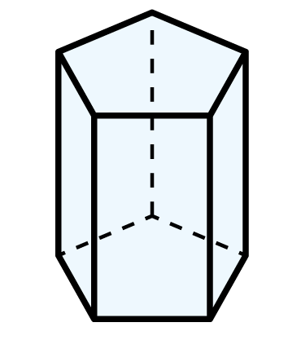
Year 3 | Week 4 | Day 2

Slide 3

Year 3 | Week 4 | Day 3

Slide 4
Year 3 | Week 4 | Day 4

Slide 5
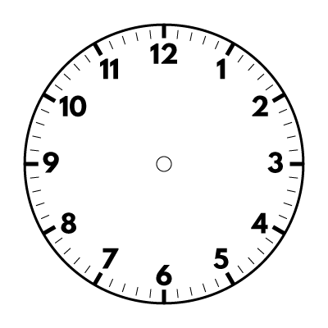

Year 3 | Week 4 | Day 5

Slide 6


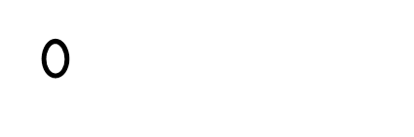

Year 3 | Week 5 | Day 1

Slide 7
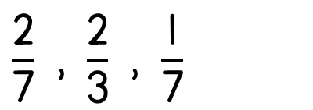
Year 3 | Week 5 | Day 2

Slide 8
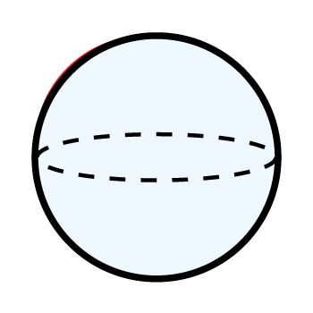
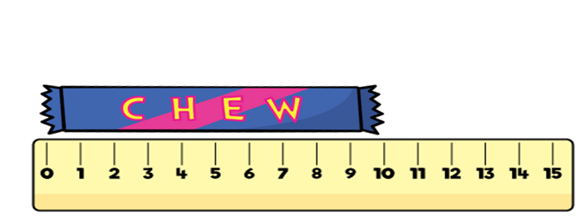
Year 3 | Week 5 | Day 3

Slide 9

Year 3 | Week 5 | Day 4

Slide 10
Year 3 | Week 5 | Day 5

Slide 11
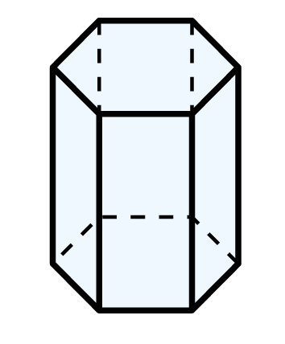
Year 3 | Week 6 | Day 1

Slide 12
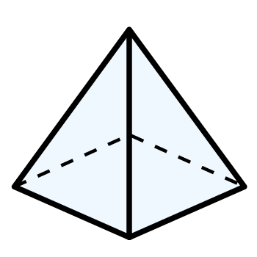
Year 3 | Week 6 | Day 2

Slide 13
Year 3 | Week 6 | Day 3

Slide 14

Year 3 | Week 6 | Day 4

Slide 15
Year 3 | Week 6 | Day 5

